Slide 1

Java Microservices
Dima Ionut Daniel

Slide 2
Contents
What are Microservices?
Features
Spring Boot
Dropwizard
WildFly Swarm
Deploy to Docker and Kubernetes
Bibliography

Slide 3

What are Microservices?
Microservices are a more concrete and modern interpretation of service-oriented architectures (SOA) used to build distributed software systems.
Services in a microservice architecture (MSA) are processes that communicate with each other over a network in order to fulfill a goal.
MSA is an approach to building software systems that decomposes business domain models into smaller systems.

Slide 4
Features
The benefit of distributing different responsibilities of the system into different smaller services is that it enhances the cohesion and decreases the coupling.
This makes it much easier to change and add functions and qualities to the system at any time.
It allows the architecture of an individual service to emerge through continuous refactoring.
It reduces the need for a big up-front design and allows for releasing software early and continuously.

Slide 5
Features (cont.)
The microservice is a separate entity.
It can be deployed as an isolated service on a platform as a service(PAAS).
The communication between the services are via network calls to enforce between the services and avoid tight coupling.
With microservices we can change a single service and deploy it independently of the rest of the system.
We allow the functionality to be consumed in different ways for different purposes.

Slide 6
Spring Boot
Spring Boot is a java framework for building microservices based on Spring DI.
It allows the creation of services through reduced boilerplate, configuration.
Spring Boot offers a large collection of sets of libraries.

Slide 7
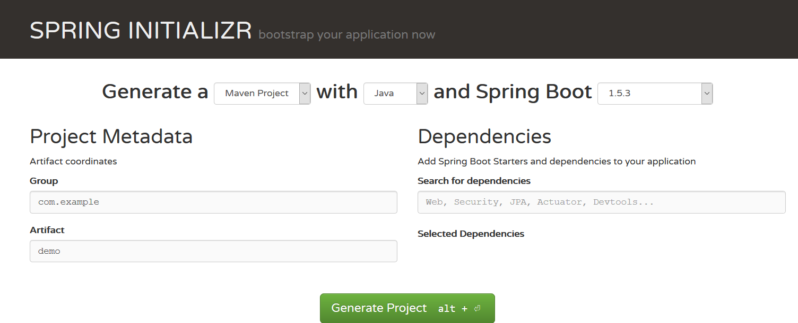
Spring Boot (cont.)
Best way to create a project is by using the Spring INITIALIZR (http://start.spring.io/).
The Spring Boot CLI can also be used also.

Slide 8
Spring Boot (cont.)
spring init --build maven --groupId com.examples --version 1.0 --java-version 1.8 --dependencies web --name hello-springboot hello-springboot
After running the command using Spring CLI a directory will be created with the name of the project.
Options:
--build: what management tool to use: maven or gradle
--groupId: used for maven
--version: application version.
--java-version: specifies compiler build version for the JDK.
--dependencies: jpa, security, cassandra.
In order to start the application with maven we need to run: mvn spring-boot:run

Slide 9
Spring Boot (cont.)
We can create rest controllers using @RestController annotation to tell Spring that we are exposing HTTP endpoints.
Using @RequestMapping we specify parts of the HTTP URI path to classes, methods and parameters in the code.
In order to build and run the application again we use: mvn clean package spring-boot:run.

Slide 10
Spring Boot (cont.)
Spring Boot makes easy the use of external properties files using @ConfigurationProperties(prefix="<PREFIX>").
Spring Boot will try to bind all properties with the prefix <PREFIX> to the Java Bean properties from the controller class.
In src/main/resources/application.properties we need to define properties like: <PREFIX>.property=value.

Slide 11
Spring Boot (cont.)
We can monitor the microservice application using Spring Boot actuator.
<dependency>
<groupId>org.springframework.boot</groupId>
<artifactId>spring-boot-starter-actuator</artifactId>
</dependency>
Available URLs are available after adding the dependency.
http://localhost:8080/beans
http://localhost:8080/env
http://localhost:8080/health
http://localhost:8080/metrics
http://localhost:8080/trace
http://localhost:8080/mappings

Slide 12
Dropwizard
Dropwizard was created in December 2011 before SpringBoot or WildFly Swarm.
Dropwizard doesn't come with a dependency-injection container like Spring or CDI.
Like Spring Boot, Dropwizard prefers to bundle the entire project into one executable uber JAR.

Slide 13
Dropwizard (cont.)
Dropwizard provides the following microservices:
Jetty for servlet container
Jersey for the REST/JAX-RS implementation
Jackson for JSON serialization/deserialization
Hibernate Validator
Guava
Metrics
JDBI for DB interaction
Logback + SLF4J

Slide 14
Dropwizard (cont.)
Jersey is the reference implementation of the JAX-RS standard (JSR 311). The Java API for RESTful Web Services make use of annotations, simplifying the development of web service applications.
Dropwizard includes Jackson, which is a fast, configurable JSON processor, and is used by Jersey to transform plain Java objects to JSON representations.
JDBI is a library that will allow us to easily create DAO interfaces in case we need database interaction.
It includes validation, monitoring, and testing modules, which we'll use to ensure that our services will behave correctly in production environments.

Slide 15
Dropwizard (cont.)
We can create a drowizard project:
mvn -B archetype:generate \
-DarchetypeGroupId=io.dropwizard.archetypes \
-DarchetypeArtifactId=java-simple -DarchetypeVersion=0.9.2 \
-DgroupId=com.examples.dropwizard
-DartifactId=hello-dropwizard -Dversion=1.0 -Dname=HelloDropwizard

Slide 16

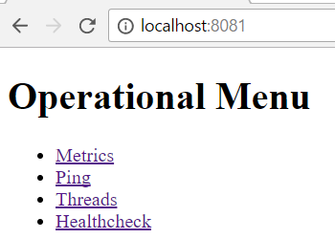
Dropwizard (cont.)
After we build and start the application by default the ports 8080 and 8081 will be used.

Slide 17
Dropwizard (cont.)
We can add HTTP endpoints using JAX-RS annotations like: @Path, @GET, etc.
In order to register the endpoints we need to register them to the Jersery envirnoment:
@Override
public void run(HelloDropwizardConfiguration configuration,Environment environment) {
environment.jersey().register(new HelloRestResource());
}
@Path("/api")
public class HelloRestResource {
@Path("/hello")
@GET
public String hello() {
return "Hola Dropwizard";
}
}

Slide 18
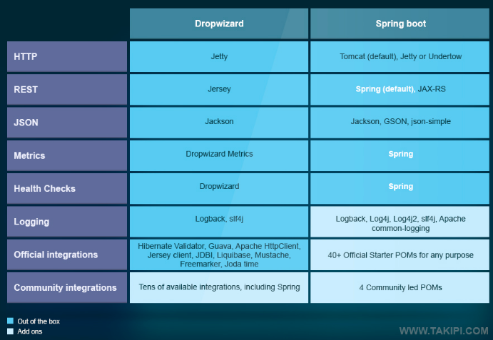
Dropwizard (cont.)

Slide 19
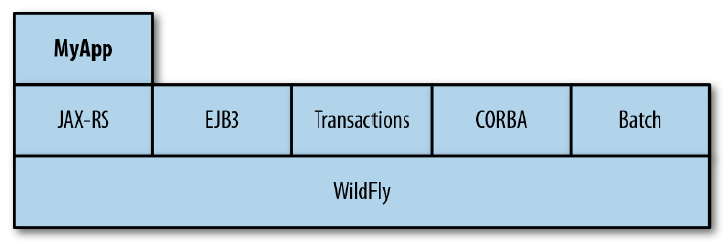
WildFly Swarm
WildFly Swarm is a the WildFly application server turned into reusable components called fractions that can be assembled into a microservice application using Java EE APIs.
The application server provides a single point for managing, deploying, configuring multiple application within a single instance.
WildFly Swarm evaluates the pom.xml(or Gradle file) and determines what JavaEE dependencies the microservice uses(servlet, EJB, messaging, CDI, JAX-RS, etc) and then builds tan uber JAR that includes the minimal JAVA EE APIs and implementations for running the service.

Slide 20
WildFly Swarm (cont.)
There are 3 ways to start working with WildFly Swarm.
using from scratch maven or gradle project add dependencies and maven plugins
using WildFly Swarm Generator web console (http://wildfly-swarm.io/generator/)
using JBoss Forge tool to generate Java project

Slide 21

WildFly Swarm (cont.)
We start Forge, add the wildfly-swarm addon and generate a new project.
The command project-new will start a wizard process.
The rest-setup command will add JAX-RS to the application.
The rest-new-endpoint command can be used to create JAX-RS endpoints.
The wildfly-swarm-run command will build and run the maven project.

Slide 22
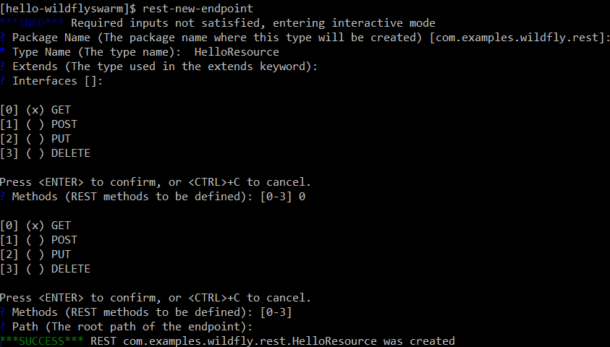
WildFly Swarm (cont.)

Slide 23
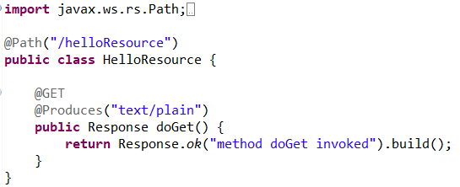
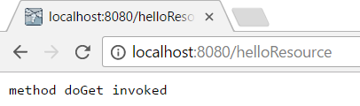
WildFly Swarm (cont.)
After we run the Forge commands we will get bellow class:

Slide 24
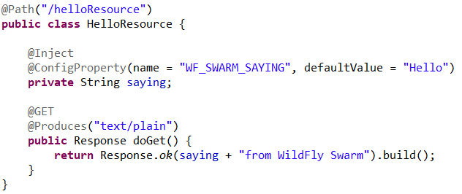
WildFly Swarm (cont.)
We can use external configuration if we add frameworks like Apache Commons Configuration and Apache DeltaSpike Configuration.
Apacge DeltaSpike is a collection of CDI extensions that can be used for configuration, data access, security.
We create a file into META-INF/apache-deltaspike.properties

Slide 25
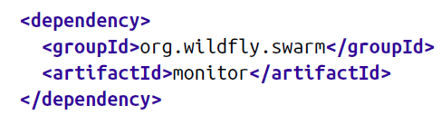
WildFly Swarm (cont.)
We can expose metrics adding the bellow dependency.
WildFly Swarm exposes some basic metrics like:
information about the node on which WildFly Swarm is running using the path /node.
JVM heap usage using the path /heap.
JVM/process thread information using the path /threads.

Slide 26
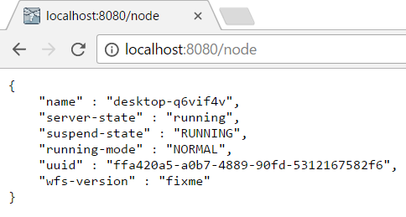
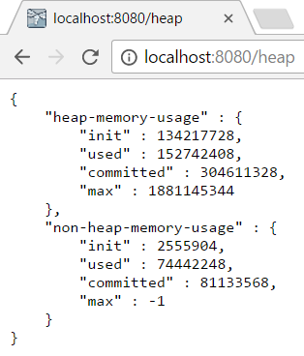
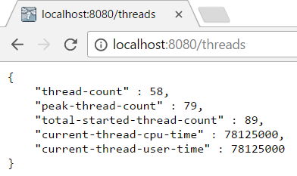
WildFly Swarm (cont.)

Slide 27
WildFly Swarm (cont.)
If we need to run the project outside maven we need to run:
mvn clean install wildfly-swarm:run

Slide 28
Deploy to Docker and Kubernetes
Docker offer a clean solution to immutable delivery.
Docker allows to package the application and all the dependencies it needs into a lightweight, layered, image format.
Dockers uses these images to run instances which run the application inside Linux containers with isolated CPU, memory, network and disk usage.
These containers are a form of application virtualization or process virtualization.

Slide 29
Deploy to Docker and Kubernetes
Google is running Linux containers at scale and are managed by the Borg cluster management platform.
Kubernetes is an open source container cluster management platform created by the same engineers who build Borg at Google.
A pod is a group of one or more Docker containers.
Labels are simple key/value pairs that we can assign to pods (node=backend, etc)
Kubernetes orchestrates, schedules and manages pods.
When an application runs inside of Kubernetes, it's running within a Docker container inside of a pod.
Kubernetetes has a concept called ReplicationController that manages the number of replicas for a given set of microservices.

Slide 30
Deploy to Docker and Kubernetes
The easy way to get started developing microservices with Docker and Kubernetes is to use Red Hat Container Development Kit (CDK).
CDK is free, small, self-contained VM that runs on a single machine that contains: Docker, Kubernetes and a web console(OpenShift)
With the CDK installed, we can build, deploy and run microservices as Docker containers and deliver microservices through other application lifecycle management features inside of OpenShift.

Slide 31
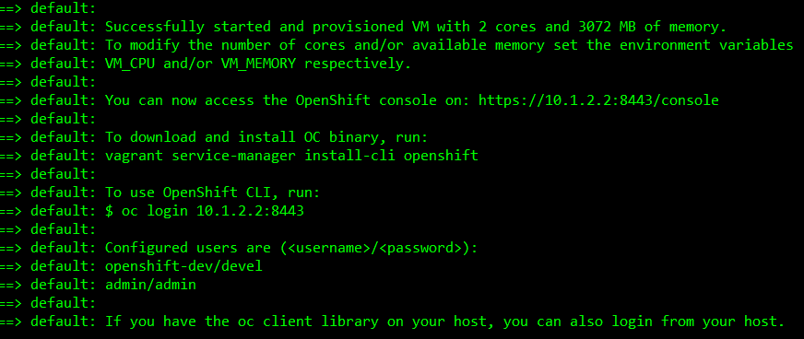
Deploy to Docker and Kubernetes
To start up the CDK we navigate ./components/rhel/rhel-ose subdirectory and execute: vagrant up

Slide 32
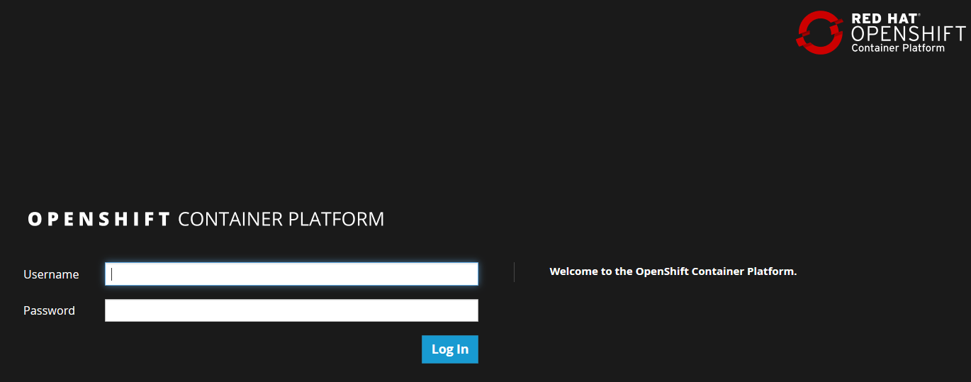
Deploy to Docker and Kubernetes
It will boot the VM that exposes a Docker daemon at tcp://10.1.2.2:2376 and the Kubernetes API at https://10.1.2.2:8443.

Slide 33
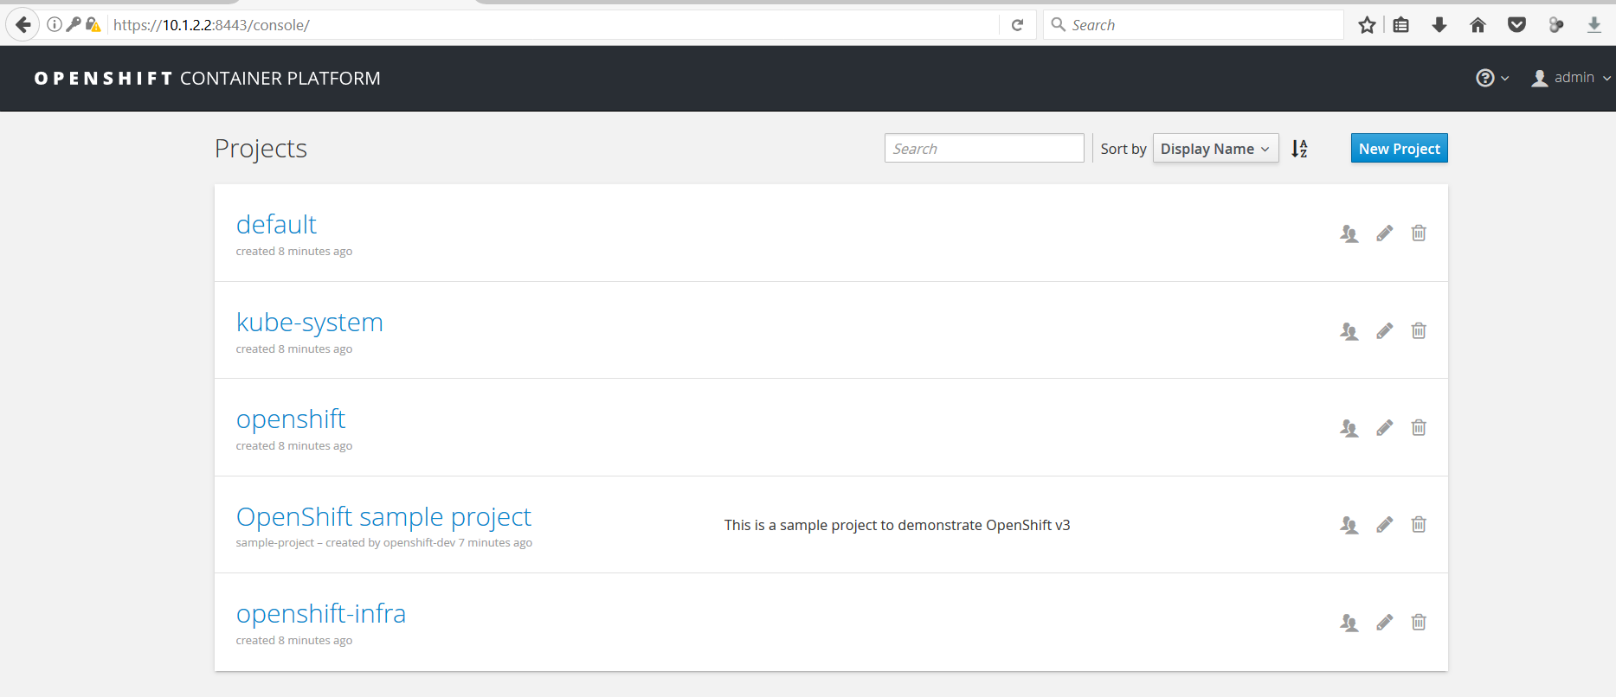
Deploy to Docker and Kubernetes

Slide 34
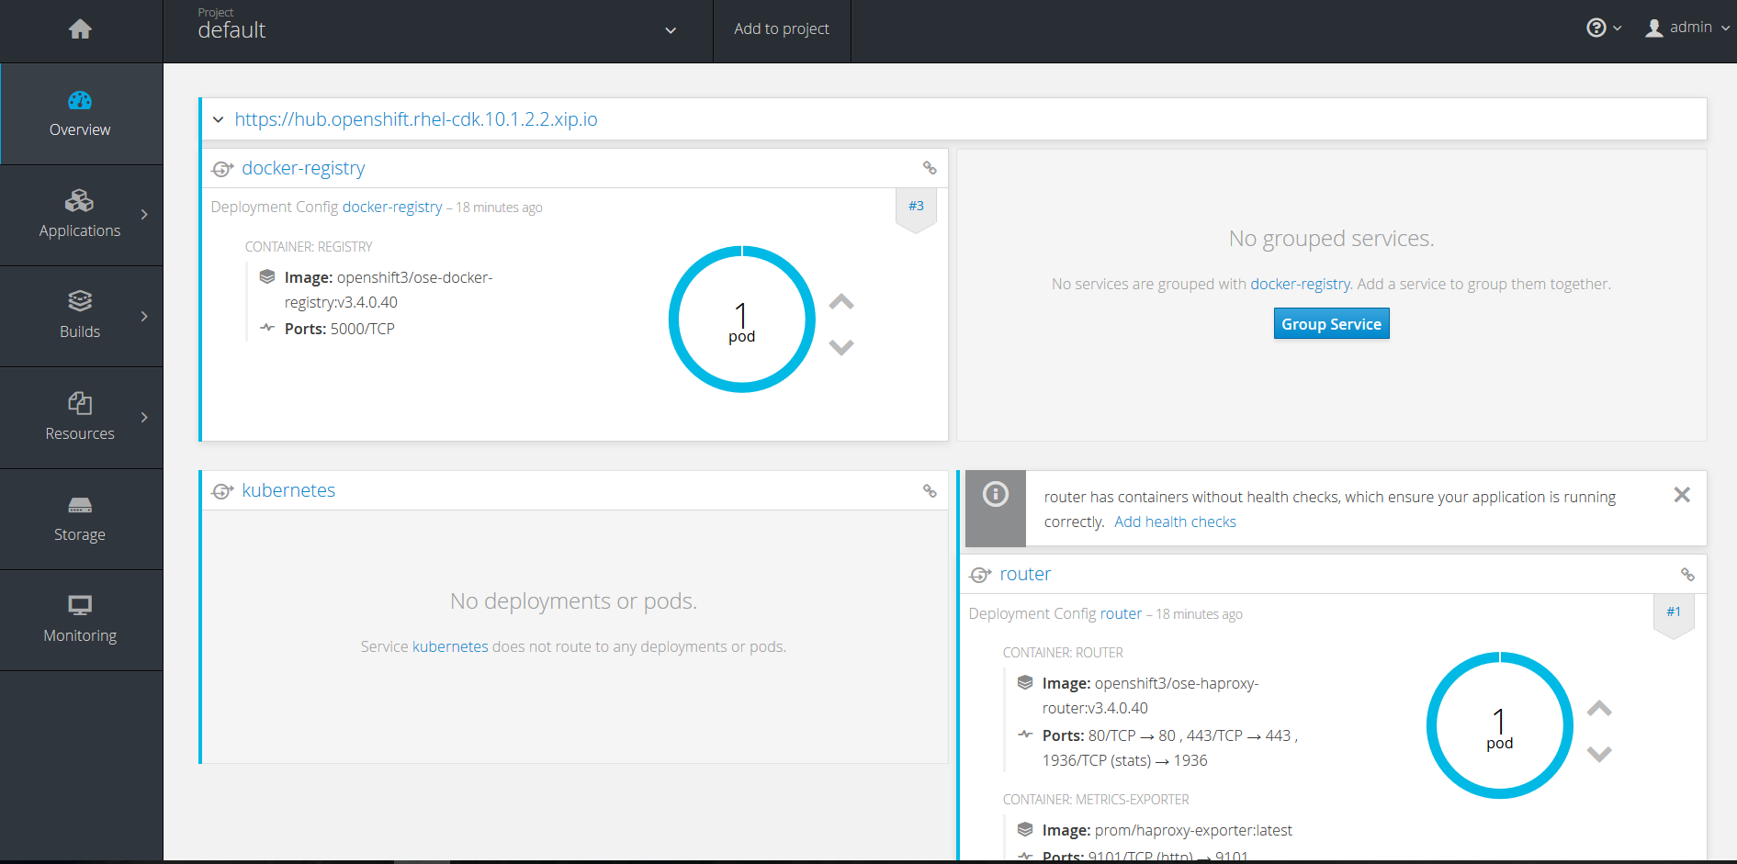
Deploy to Docker and Kubernetes

Slide 35

Bibliography
https://en.wikipedia.org/wiki/Microservices
O'Reilly - Microservices for Java Developers

